Slide 1
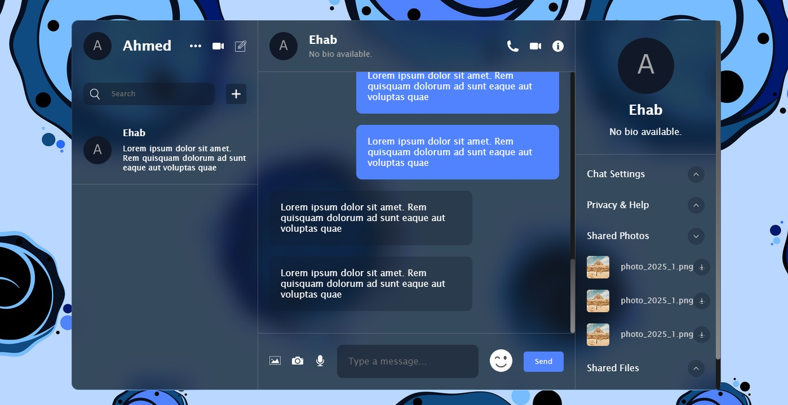
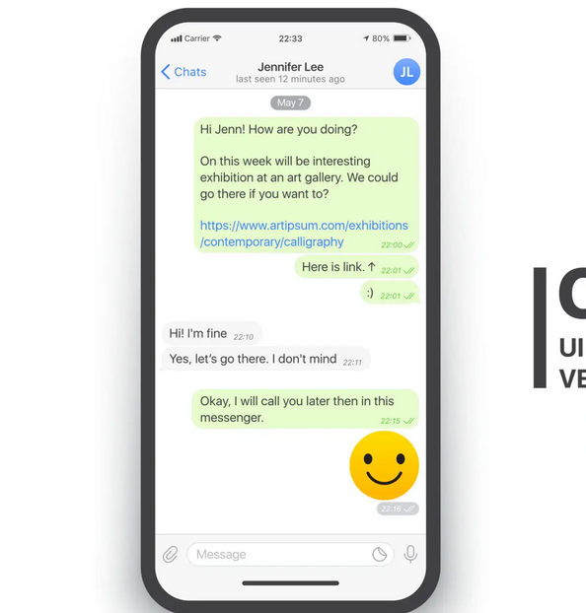

Real Time Chat App Using React
Built Using React, Node.js, and Firebase

Slide 2
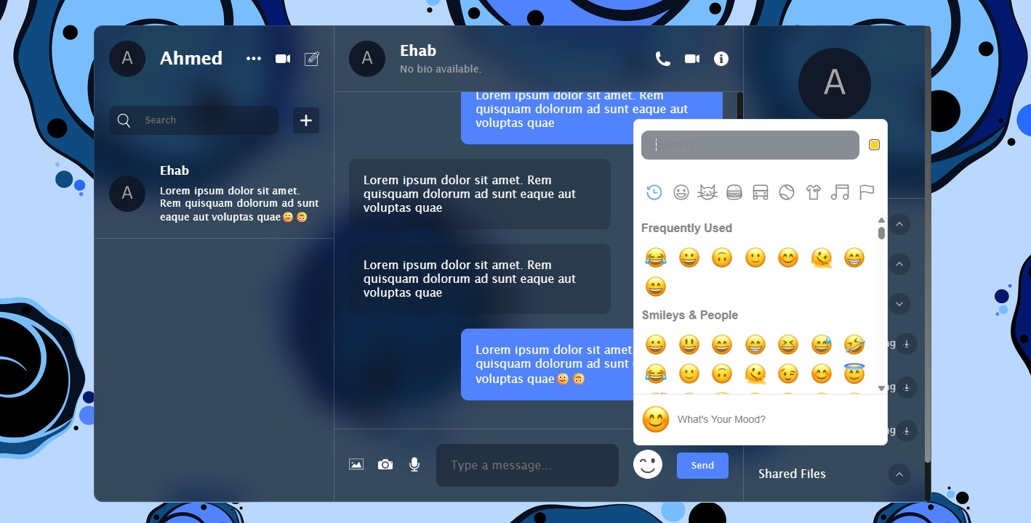
What is the Chat App?
A messaging web application that allows users to:
Signin/Signup
Responsive chat application
Chat in real-time with others
Built using:
React for the frontend
Node.js for backend
Firebase for real-time database and authentication

Slide 3
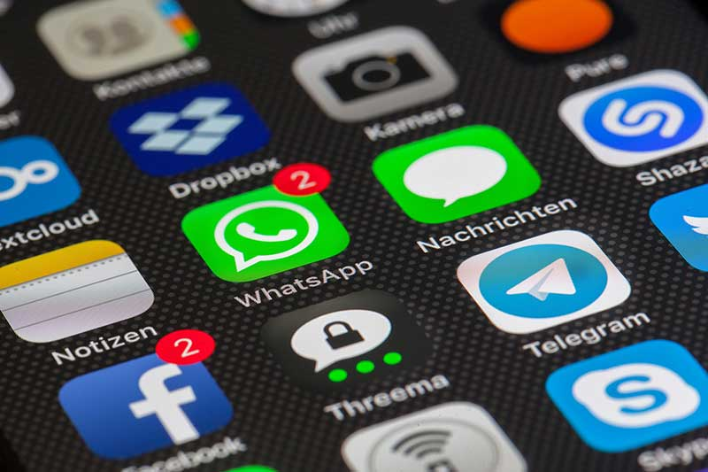
Why This Project?
Communication apps are widely used in daily life.
The chat app solves a real problem: instant communication.
It’s a great way to combine many skills:
Frontend development
Real-time databases
User authentication
Hosting and deployment

Slide 4

Team Members & Responsibilities
This project was divided into 4 clear roles:
Ahmed Ehab: Testing + Documentation
Ahmed Tarek: Firebase Auth & Database
Joseph George: React frontend ( chat component )
Amr Khaled: React frontend (UI design &wireframe)
Weekly sync meetings to share updates and issues

Slide 5

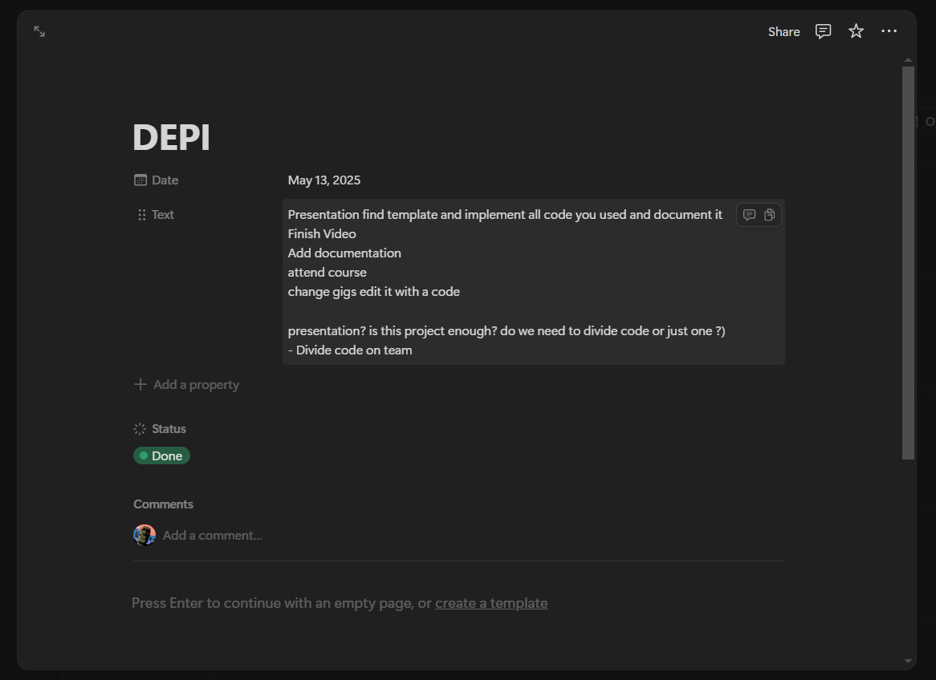
How We Planned & Managed the Project
Used Figma for designing UI mockups
Notion for task management
GitHub for version control and collaboration
Planned the project in phases:
UI design
Frontend setup
Backend & Firebase
Testing and Deployment

Slide 6
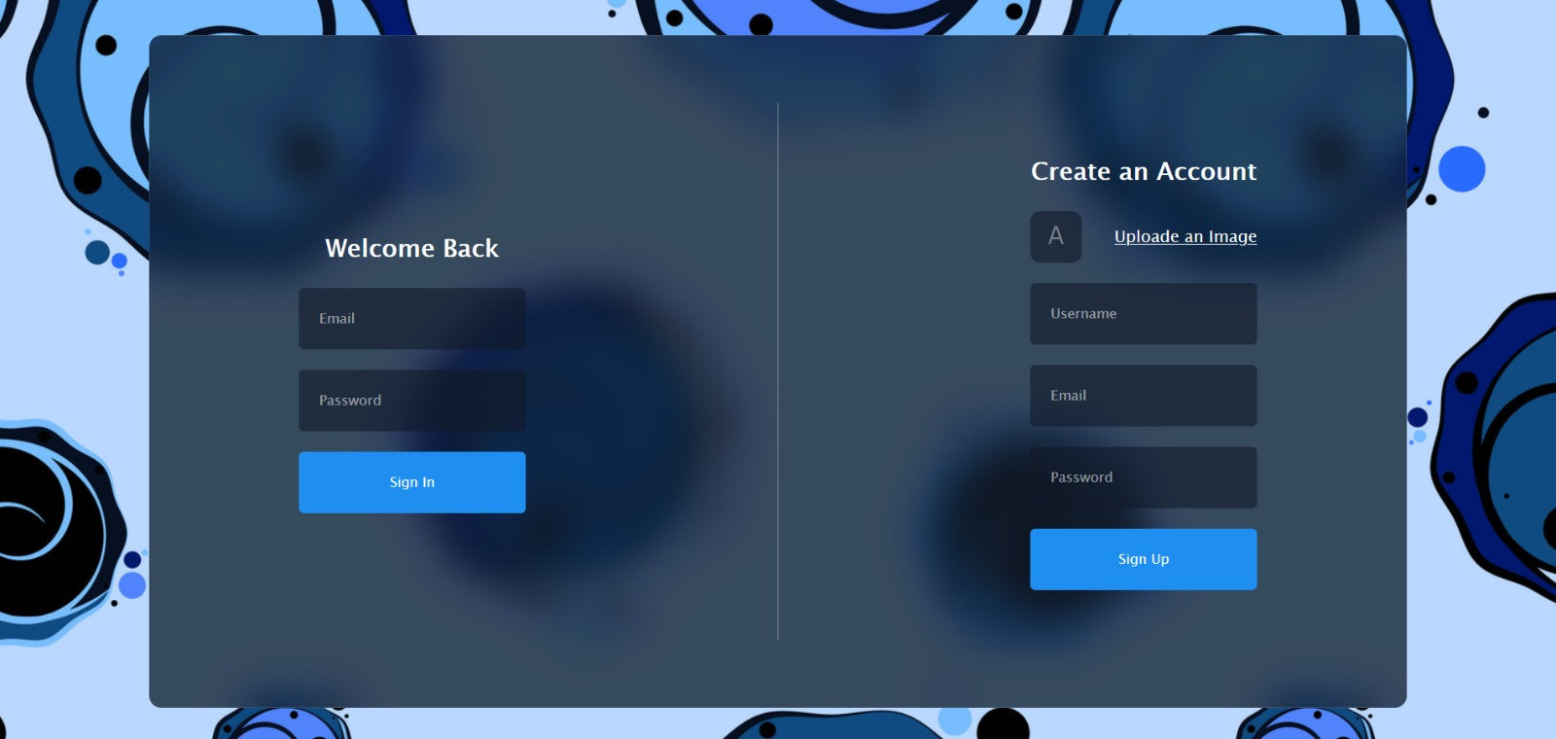
Design Philosophy of the App
Focused on minimal, clean, and functional design
Chose a color palette similar to WhatsApp
Responsive layout: works on desktop and mobile
Designed for simplicity, speed, and readability

Slide 7


User Interface Previews
Here is some Screenshots of our UI

Slide 8
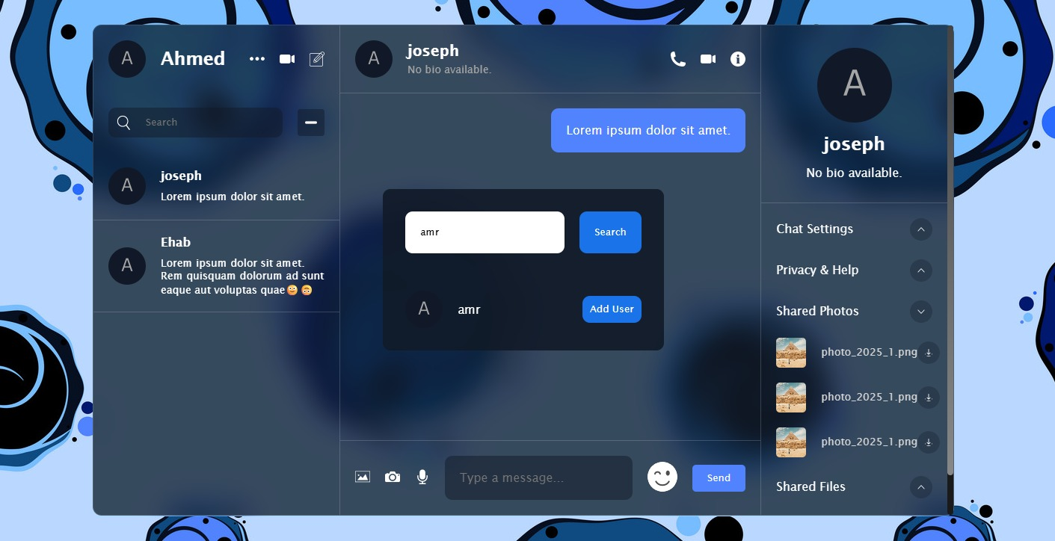
UI Preview
Chat bubble UI
Login/Signup page
Main Chat page
Sidebar/User list

Slide 9
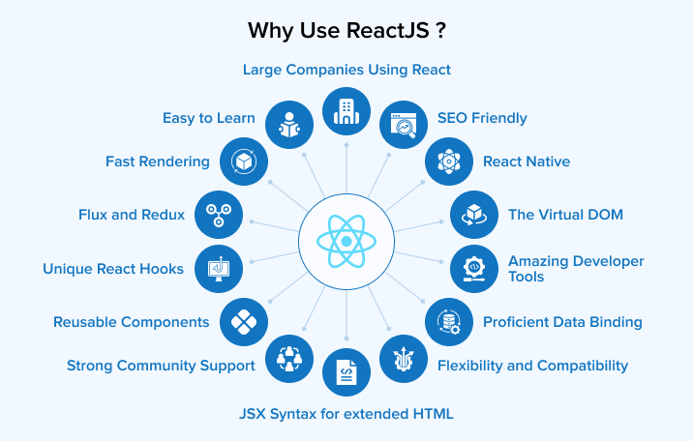
Main Functional Features
User registration via Firebase Authentication
Secure login/logout system
Sessions persist (stay logged in)
Error handling (e.g., incorrect password, invalid email)

Slide 10
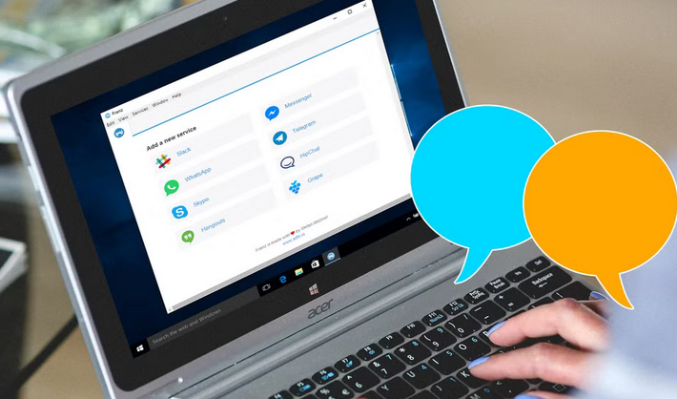
Main Functional Features
Real-time messaging using Firebase Firestore
Messages appear instantly without page reload
Timestamps on each message
Messages ordered by time
Messages stored securely in Firestore

Slide 11
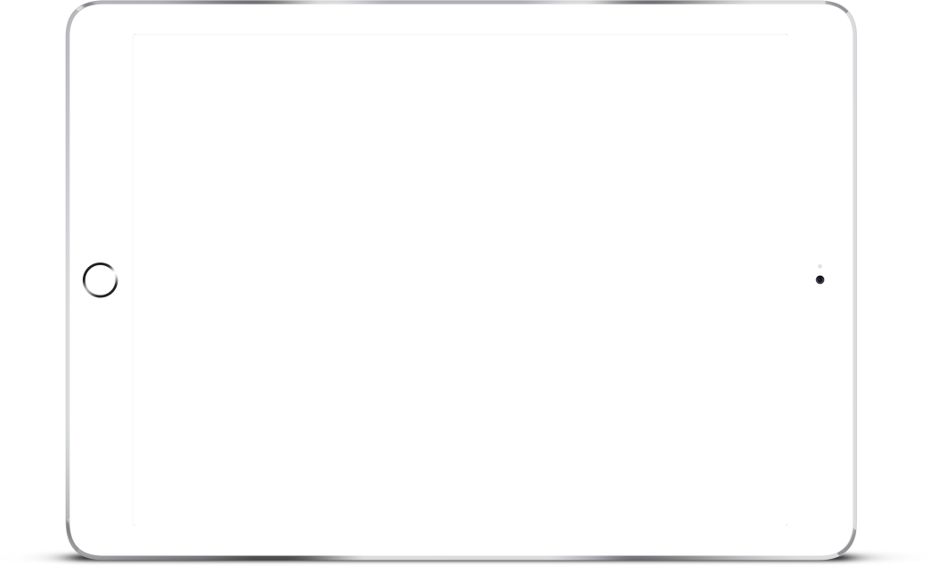
Extra Features
Some cool features we implemented…

Slide 12
Tools Used in the Frontend
React.js
React Router
CSS/Tailwind
React Hooks
Used for building UI components and routing
Handles page navigation (Login ↔️ Chat)
Used for styling and responsive design
Manage state and lifecycle in components

Slide 13
Backend & Real-Time Services
Node.js & Express
Firebase Authentication
Firebase Firestore:
Firebase Hosting
REST API layer (e.g., for message routes or file uploads)
Manages user accounts and session persistence
Real-time NoSQL cloud database
Every message update is synced instantly
Will be used for For deployment

Slide 14
API: Connecting Frontend & Backend
What is & Why we used an API?
API is an Application Programming Interface
Allows frontend to request/send data from backend or cloud services
What API do we used?
Firebase SDK APIs used to:
Create users (Auth)
Send/receive messages (Firestore)

Slide 15
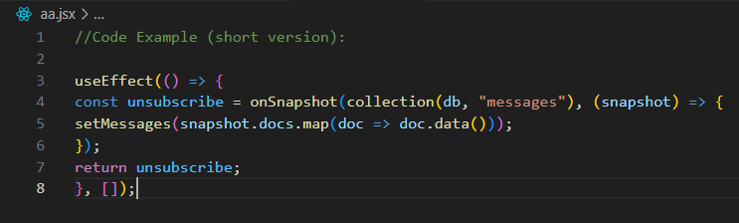
Chat Component Logic
a Key part of our code :
useEffect to listen for Firestore updates
useState to track messages and input
onSendMessage function
Pushes message to Firestore
Clears input field

Slide 16
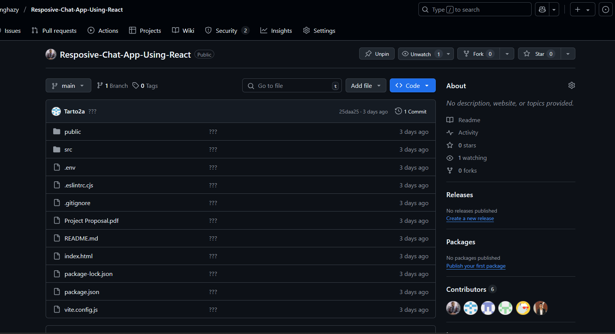
Source Code & Collaboration
GitHub link:
https://github.com/binghazy/Resposive-Chat-App-Using-React.git
------------------------------------------------
README includes:
Setup instructions
Live demo link
Screenshots

Slide 17
Steps from Idea to Deployment
3.Tested messaging and authentication
Debugged and optimized performance
1. Initial Idea from real-world use case Designed wireframes with Figma
4. Final testing and deployment
Shared live link and source code
5. Divided Auth tasks and deployment
2. Divided frontend, backend
Built components & connected Firebase

Slide 18


What We Learnt
Summarization of this initiative

Slide 19
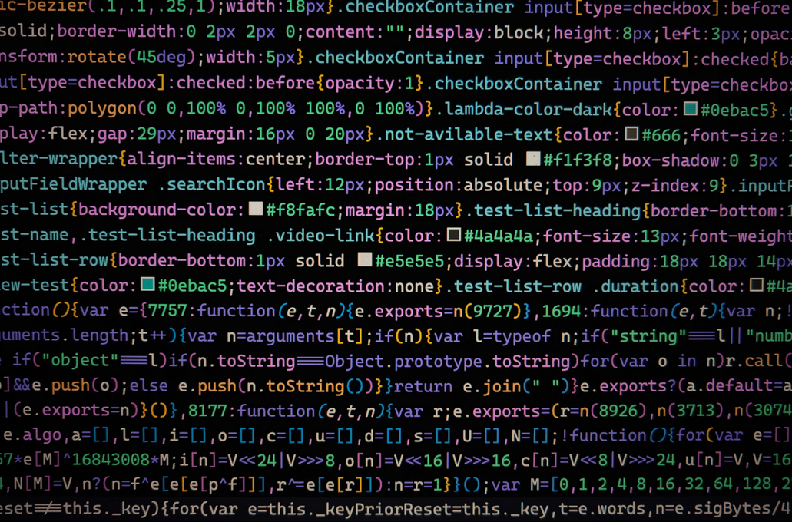
Lessons & Skills Gained
Full-stack integration: React + Firebase
Authentication & protected routes
Using Firestore for real-time updates
Hosting & deployment with Firebase/Vercel
Team collaboration using GitHub & planning tools
Debugging async data flows

Slide 20
Team Members
Ahmed Ehab Fathy Ghazy ______________ Ahmed Tarek Salah Ibrahim
Amr Khaled Mahrous Mohamed
______________ Joseph George Mounir Ishaq

Slide 21

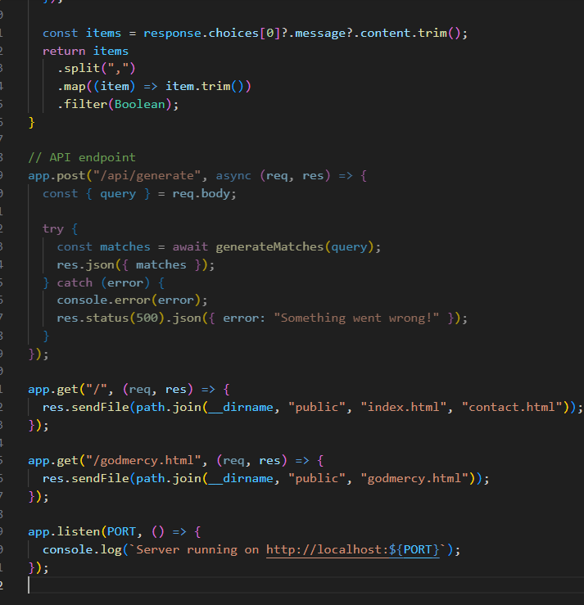
Thank You

